Slide 1
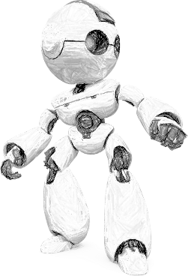
Computer Vision using Deep Learning
By Aditya Bhattacharya
Lead AI/ML Engineer, West Pharmaceuticals
AI Researcher, MUST Research
https://aditya-bhattacharya.net/

Slide 2
Topics to be discussed
Convolutional Neural Networks ( CNN or ConvNets )
Popular ConvNet Architectures
Data Augmentation
Transfer Learning
Object Detection
Neural Style Transfer
Generative Adversarial Networks (GANs)
Variational Auto Encoders (VAEs)

Slide 3
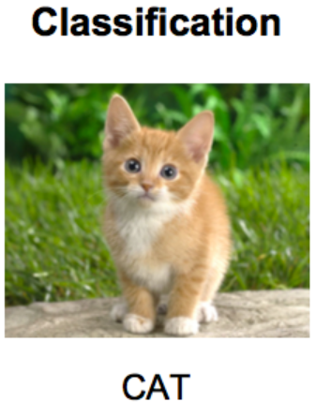
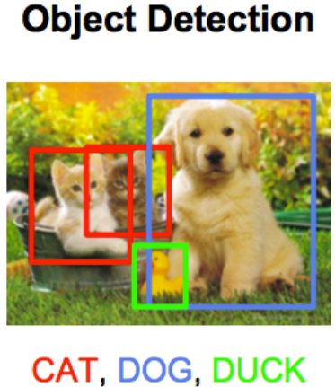
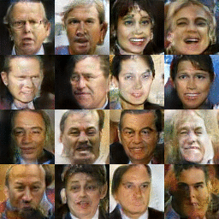
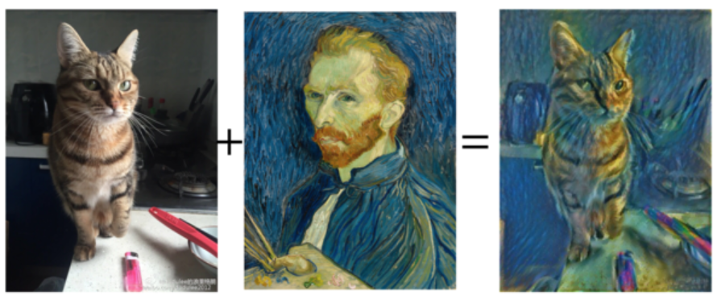
Typical Computer Vision Problems
Image Classification
Object Detection
Neural Style Transfer
Image Generation
Neural Style Transfer
Image Generation
Notes:
Notes: Images have been taken from:
https://raw.githubusercontent.com/torch/torch.github.io/master/blog/_posts/images/out.gif
https://i.stack.imgur.com/mFBCV.png
https://cdn-images-1.medium.com/max/1600/0*JTxhYFzNFZ0xlWlB.png

Slide 4
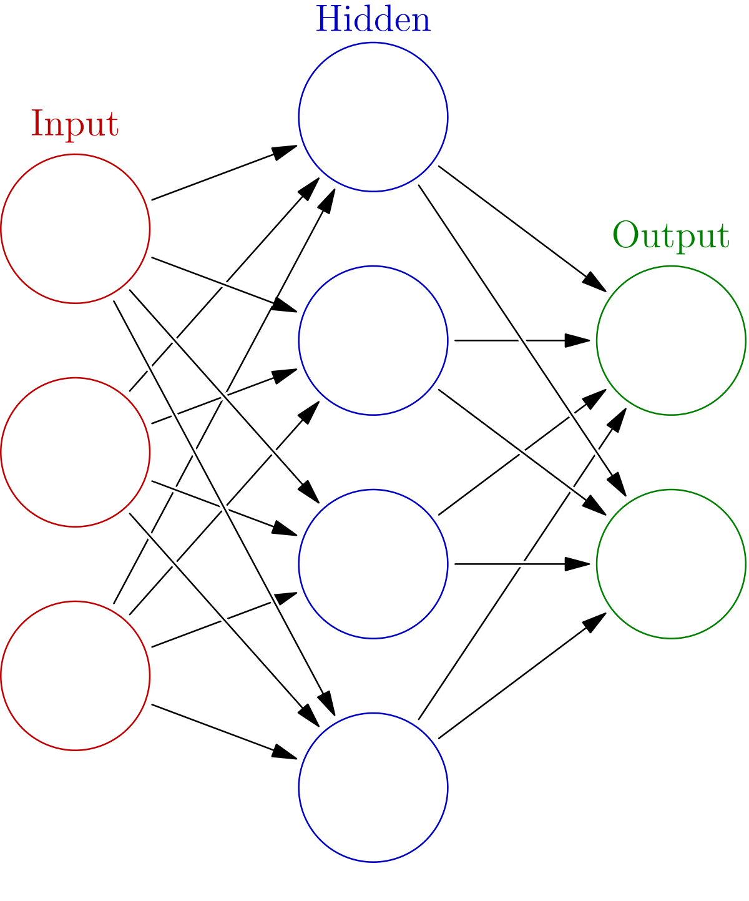

Convolutional Neural Networks (CNN or ConvNets)
Why CNN? Why not classical ML approach?
Classical ML approach requires a lot of research on the dataset for feature engineering
Requires cleaner dataset for higher accuracy
Accuracy of the algorithms were not good enough with classical ML approach
CNNs are far more accurate and reliable and easier to implement
Notes:
Reference image has been taken from:
https://medium.freecodecamp.org/an-intuitive-guide-to-convolutional-neural-networks-260c2de0a050

Slide 5
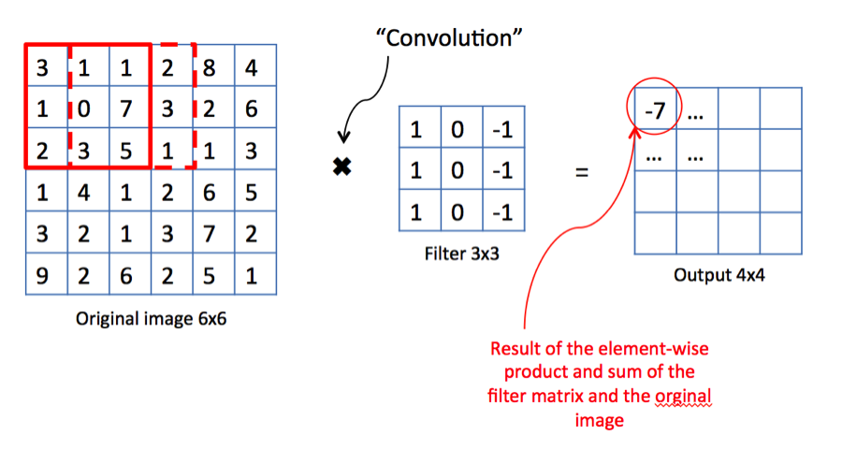
Convolutional Neural Networks (CNN or ConvNets)
How does a convolution work?
Valid Convolution
(n x n) * (f x f) = (n-f+1) x (n – f +1)
Padding and Strided convolution ?
(n x n) * (f x f) = ((n + 2p –f) /s ) + 1) x ((n + 2p –f) /s ) + 1)
original
Same Convolution
Notes:
Reference image has been taken from:
https://medium.freecodecamp.org/an-intuitive-guide-to-convolutional-neural-networks-260c2de0a050

Slide 6
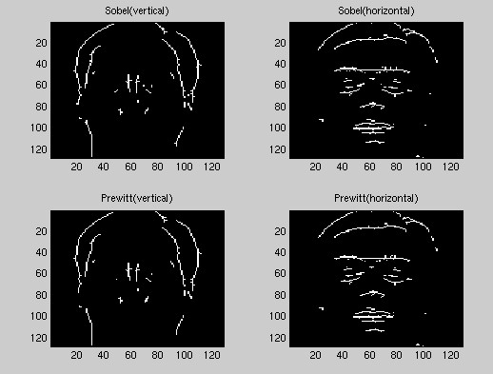
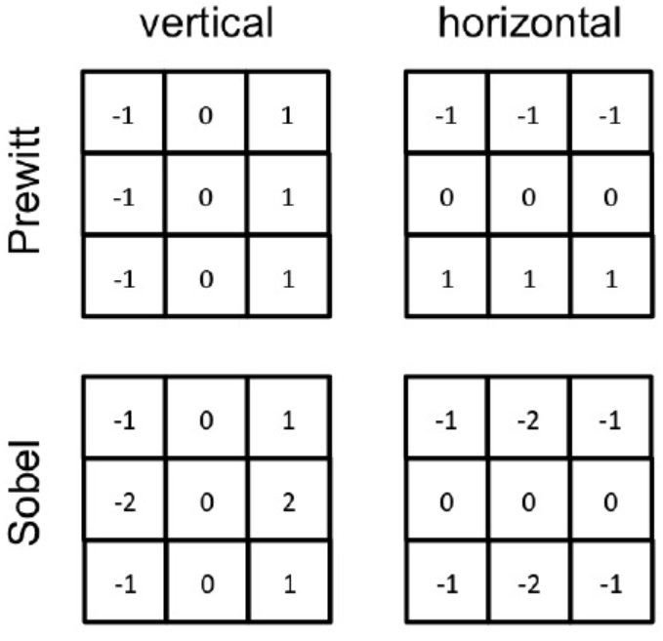
Convolutional Neural Networks (CNN or ConvNets)
Edge Detection
Notes:
Reference image has been taken from:
https://medium.freecodecamp.org/an-intuitive-guide-to-convolutional-neural-networks-260c2de0a050
https://www.owlnet.rice.edu/~elec539/Projects97/morphjrks/moredge.html

Slide 7
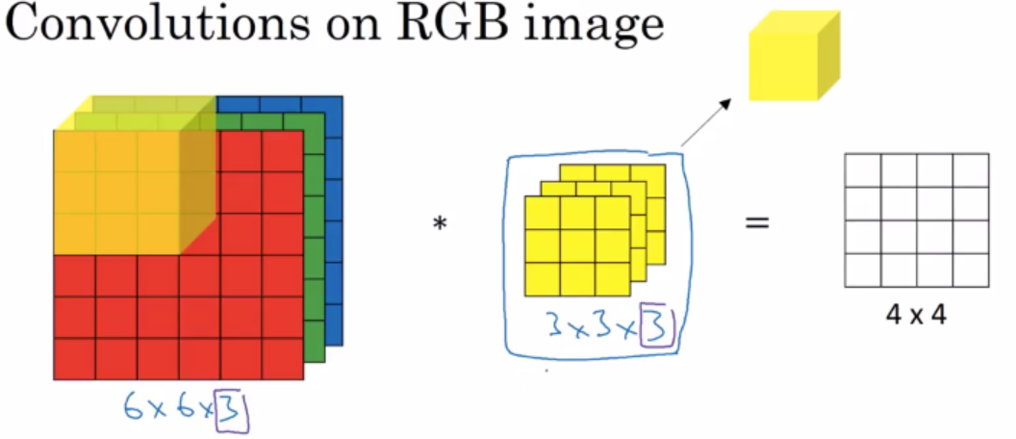
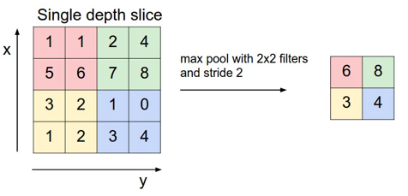
Convolutional Neural Networks (CNN or ConvNets)
Pooling
Deep Convolution Neural Network
Notes:
Reference image has been taken from:
https://medium.freecodecamp.org/an-intuitive-guide-to-convolutional-neural-networks-260c2de0a050
https://i.stack.imgur.com/QZsRB.png

Slide 8
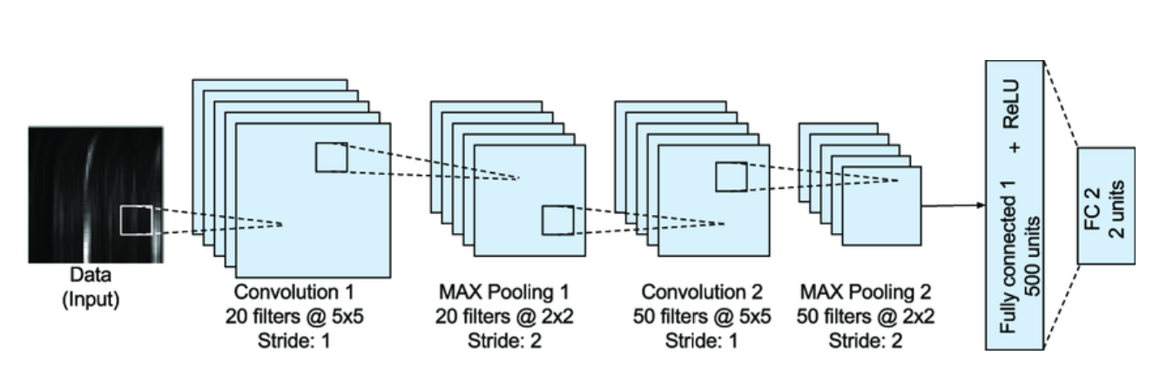
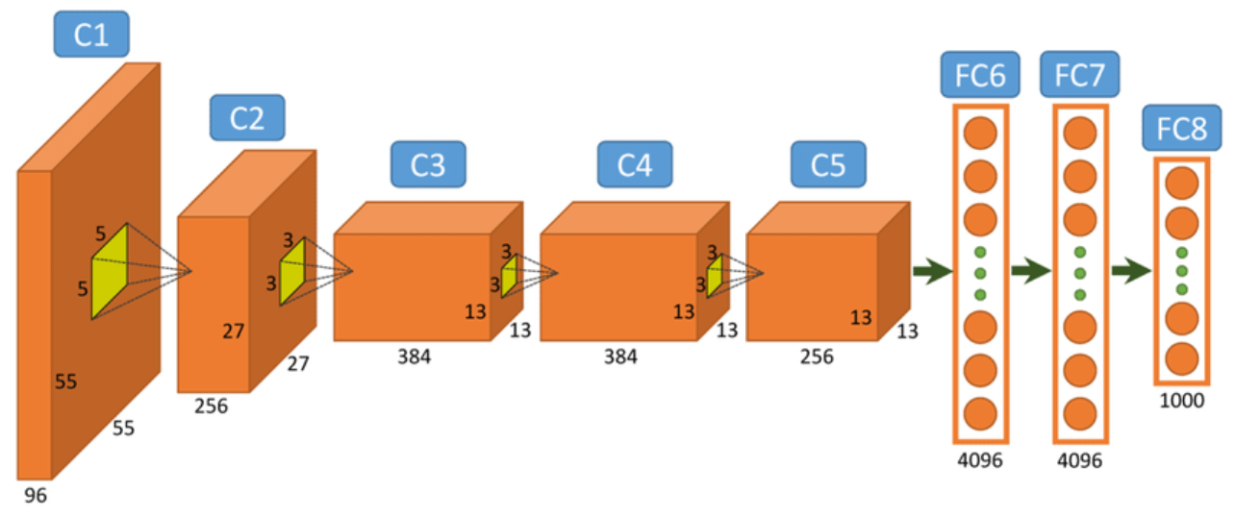
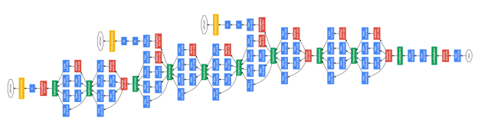
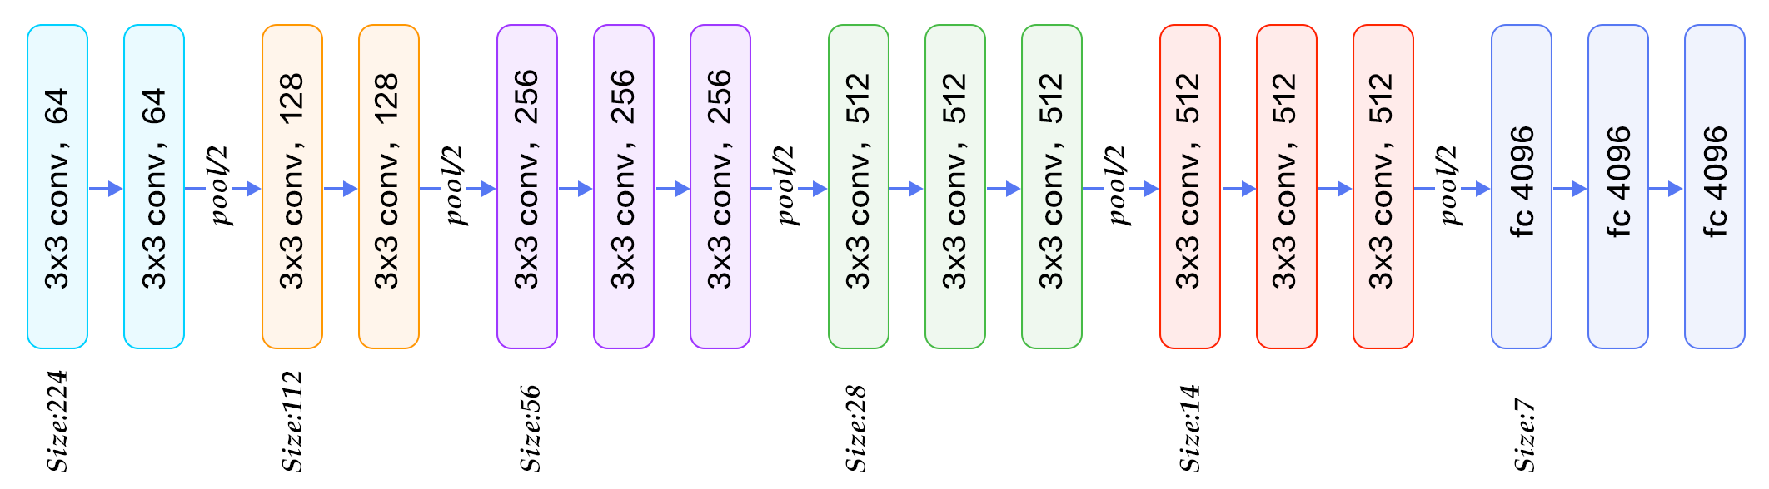
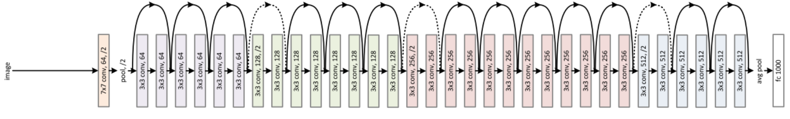
Popular ConvNet Architectures
LeNet
AlexNet
VGG
Inception Net
ResNet

Slide 9
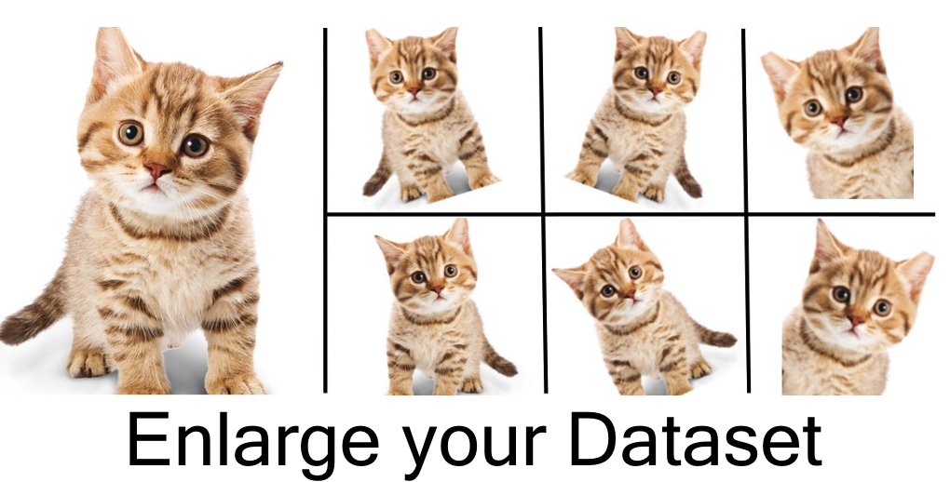
Data Augmentation
Why Data Augmentation?
With a smaller dataset over-fitting is a huge problem.
Data augmentation helps you to expand your dataset from available data in an unbiased way.
Types of operation
Mirroring
Random Crop
Rotation
Shearing
Warpig
Colour Shifting
Notes:
https://cdn-images-1.medium.com/max/1200/1*C8hNiOqur4OJyEZmC7OnzQ.png
https://www.kdnuggets.com/2018/05/data-augmentation-deep-learning-limited-data.html

Slide 10
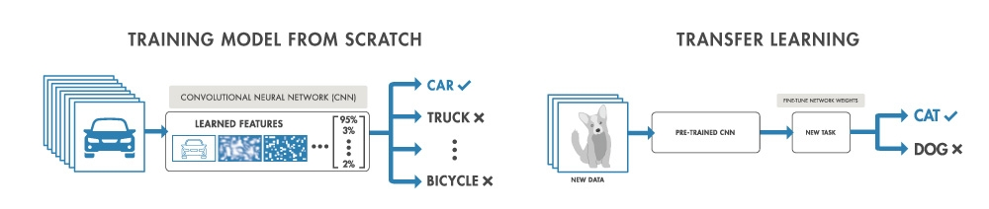
Transfer Learning
What is transfer learning?
A deep learning approach to use a pretrained network or model and fine tune it and re-train with custom labels to obtain solution for a similar problem.
Example : Working with ImageNet
Why transfer learning?
CV requires a large dataset, which might not be available all the time.
Much faster and reliable approach than training a CNN from scratch.
Notes:
https://www.mathworks.com/discovery/transfer-learning.html

Slide 11
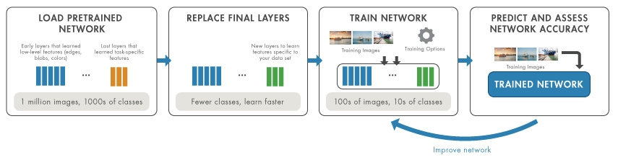
Transfer Learning
Working on Pre-Trained networks
Load a pretrained network
Replace the final layer including the output layer
Fine tune the weights depending on new task and new data
Train the network on the data for new task
Test the accuracy of the new network and tune the model if required.
Notes:
https://www.mathworks.com/discovery/transfer-learning.html

Slide 12
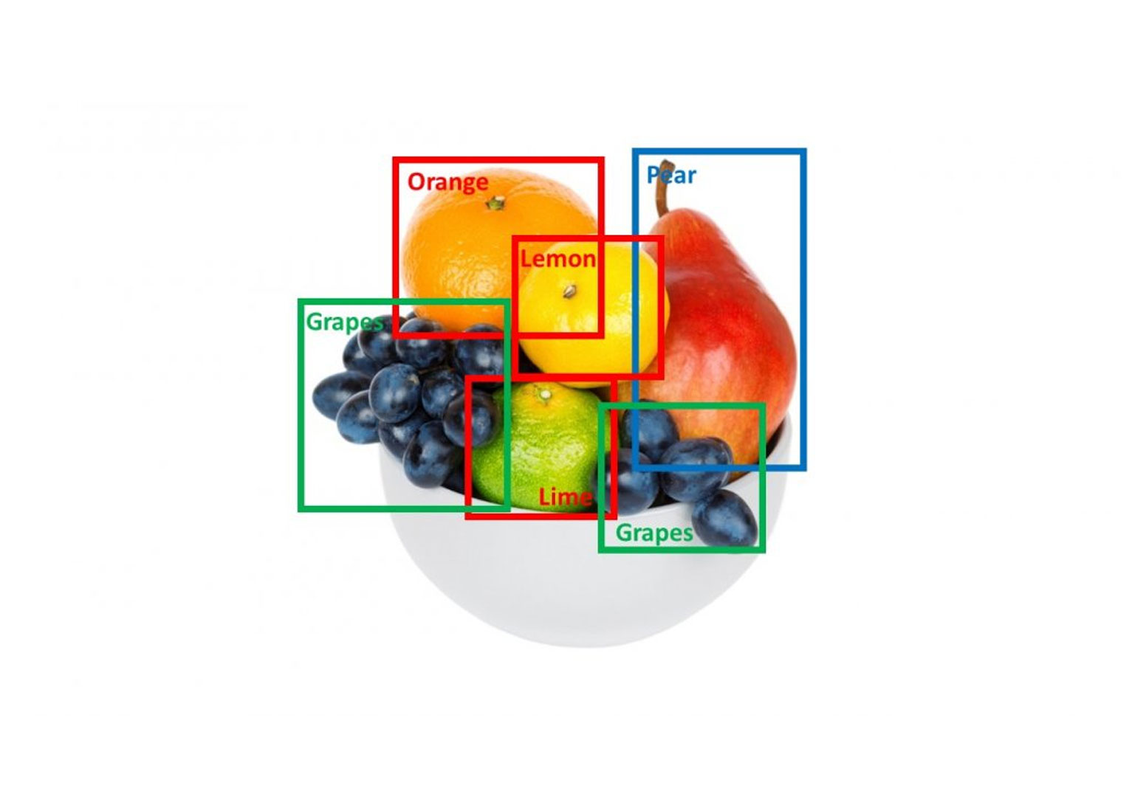

Object Detection
Typical challenges with Object Detection:
Classification with Localization, detect and then localize
Bounding box
Landmark detection
What typical output your algorithm should look for?
Whether your image has the particular object (Pc)
Bounding box coordinates (bx,by)
Bounding box height and weight (bh,bw)
Number of classes ( C1, C2, C3 …)

Slide 13
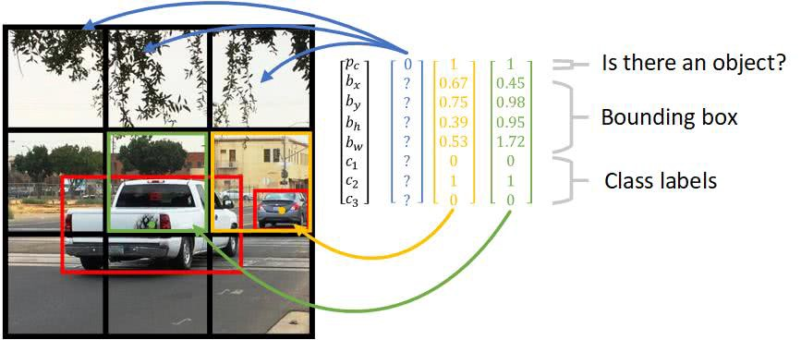
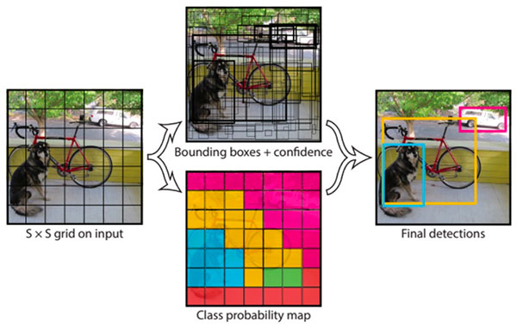
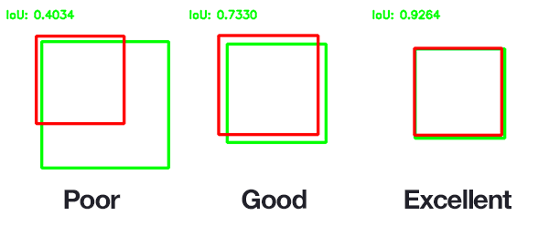
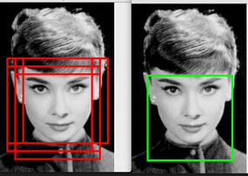
Object Detection with YOLO algorithm
Yolo – You Only Look Once
YOLO divides the input image into an S×S grid. Each grid cell predicts only one object
For each grid cell, it predicts B boundary boxes and each box has one box confidence score,
It detects one object only regardless of the number of boxes B,
It predicts C conditional class probabilities (one per class for the likeliness of the object class).
Intersection over union (IoU)
Non-max suppression
Notes:
https://medium.com/@jonathan_hui/real-time-object-detection-with-yolo-yolov2-28b1b93e2088
https://leonardoaraujosantos.gitbooks.io/artificial-inteligence/content/single-shot-detectors/yolo.html

Slide 14
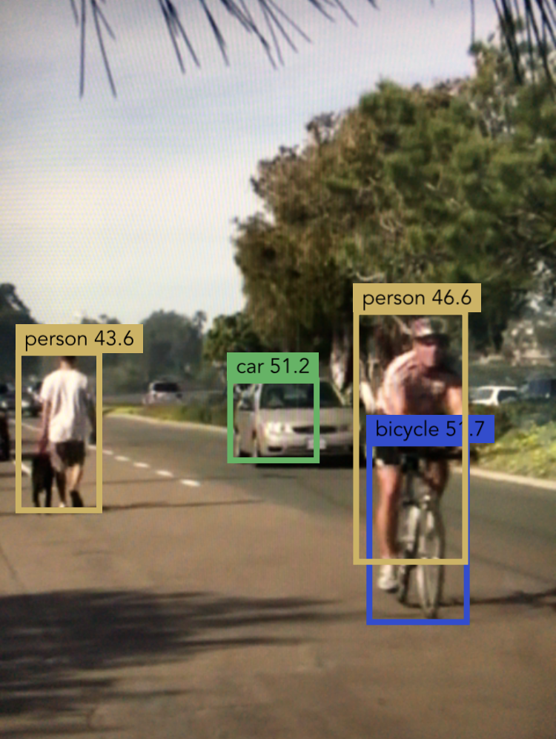
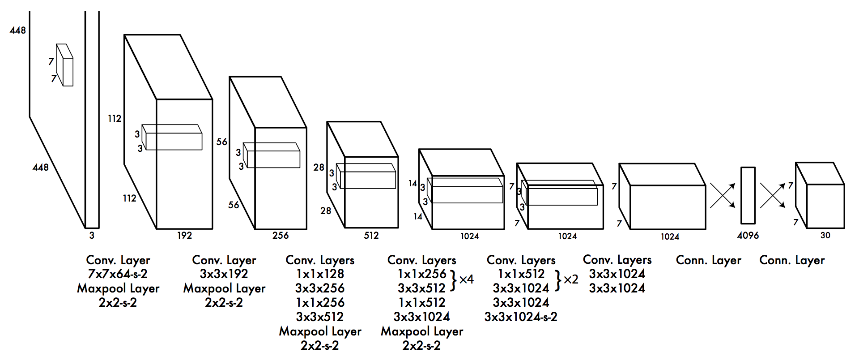
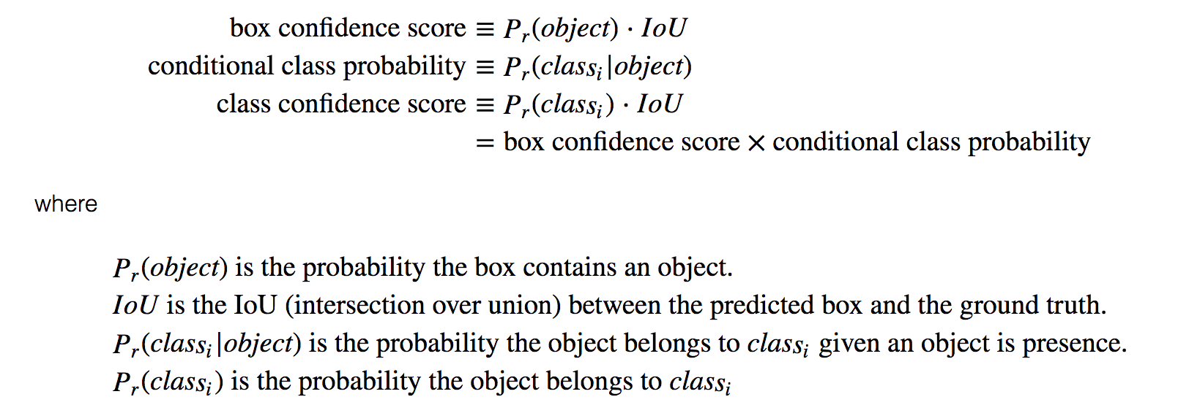
YOLO
YOLO uses sum-squared error between the predictions and the ground truth to calculate loss. The loss function composes of:
the classification loss.
the localization loss (errors between the predicted boundary box and the ground truth).
the confidence loss

Slide 15
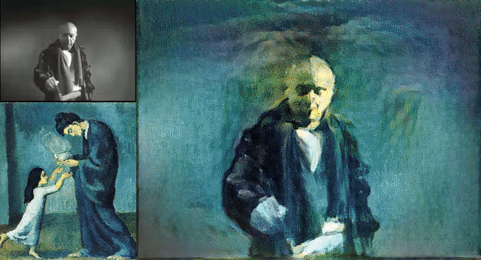
Neural Style Transfer
Learn features from different layers of ConvNet
The key notion behind implementing style transfer :
define a loss function to specify what we want to achieve,
minimize this loss.
main loss functions primarily compute the distance in terms of these different representations.
Content image + Style Image = Generated image
What we want to achieve?
Conserve the contents of the original image
Adopt the style of the reference image.
Notes:
https://www.matthewwilson.co/tomtom
https://www.pyimagesearch.com/2018/08/27/neural-style-transfer-with-opencv/

Slide 16
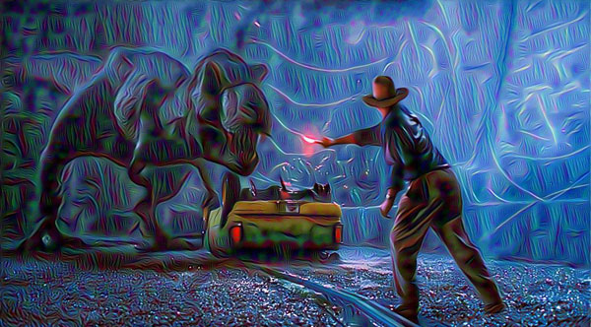
Neural Style Transfer
How do we define a neural network to perform style transfer?
The original 2015 paper by Gatys et al. proposed a neural style transfer algorithm that does not require a new architecture at all.
We can take a pre-trained network (typically on ImageNet) and define a loss function that will enable us to achieve our end goal of style transfer and then optimize over that loss function.
What loss function do we use?
Content loss
Style loss
Total-variation loss
Notes:
https://www.pyimagesearch.com/2018/08/27/neural-style-transfer-with-opencv/

Slide 17
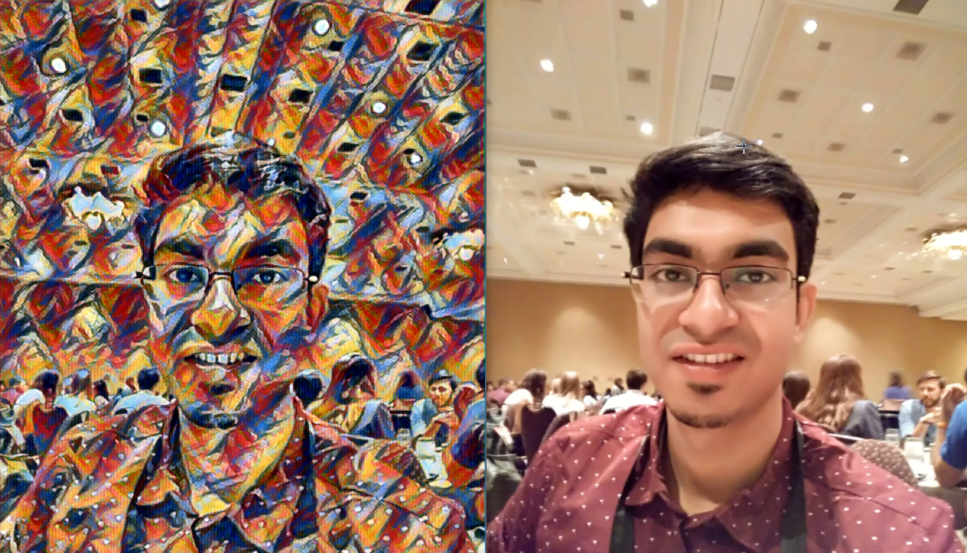

Slide 18
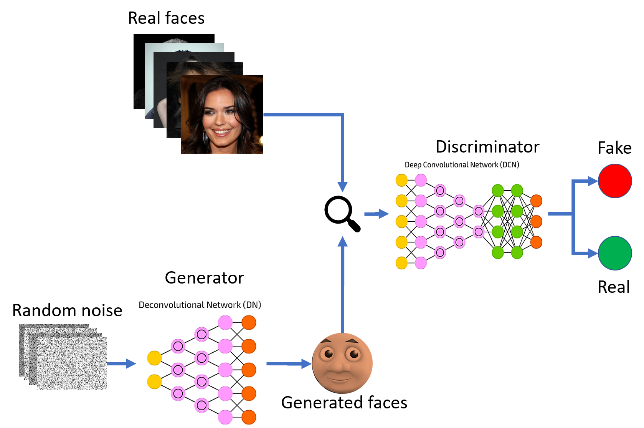
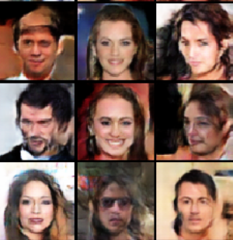
Generative Adversarial Networks (GANs)
A GAN is made up of two parts:
Generator network - Takes as input a random vector (a random point in the latent space), and decodes it into a synthetic image
Discriminator network (or adversary) - Takes as input an image (real or synthetic), and predicts whether the image came from the training set or was created by the generator network.
Notes:
https://www.spindox.it/en/blog/generative-adversarial-neural-networks/
Deep Learning with Python by Chollet

Slide 19
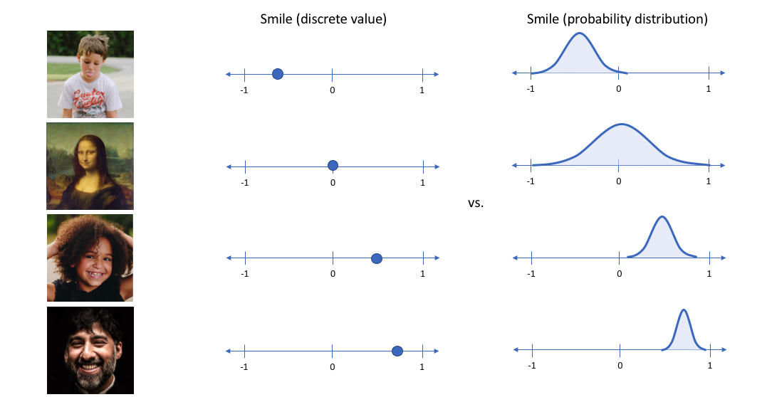
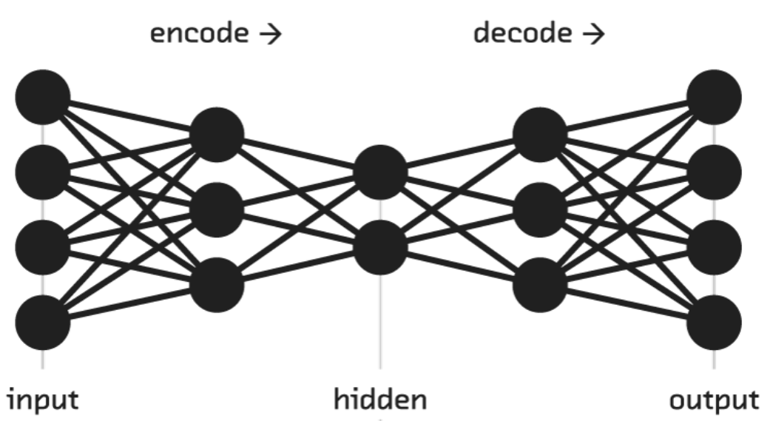
Variational Auto Encoders (VAEs)
Textbook definition of a VAE - “provides probabilistic descriptions of observations in latent spaces.”
Each input image has features that can normally be described as single, discrete values.
Variational autoencoders describe these values as probability distributions.
Decoders can then sample randomly from the probability distributions for input vectors
Notes:
https://towardsdatascience.com/what-the-heck-are-vae-gans-17b86023588a

Slide 20
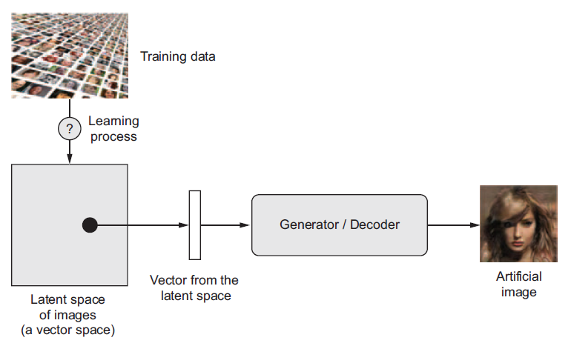
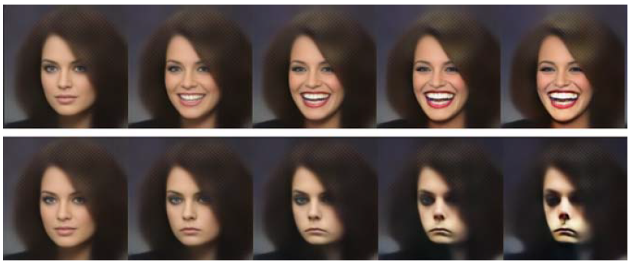
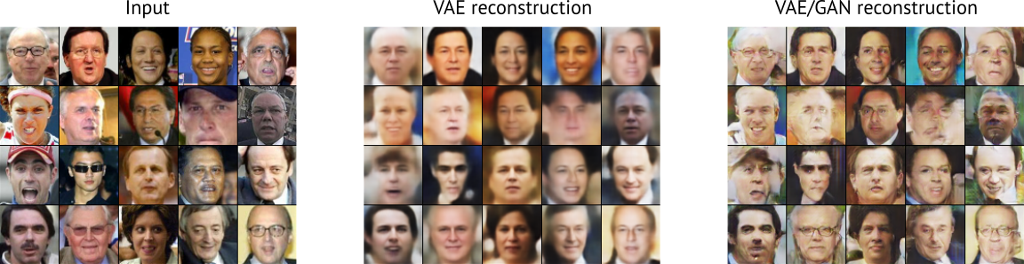
Variational Auto Encoders (VAEs)
Notes:
https://towardsdatascience.com/what-the-heck-are-vae-gans-17b86023588a

Slide 21
Thanks
Questions?
- Want to connect over LinkedIn ?
Or email me at:
aditya.bhattacharya2016@gmail.com
Follow me @ https://aditya-bhattacharya.net/
By Aditya Bhattacharya
Lead AI/ML Engineer,
West Pharmaceuticals
MUST Research

